Slide 1
Informed search algorithms

Slide 2
Outline
Best-first search
Greedy best-first search
A* search
Heuristics
Local search algorithms
Hill-climbing search
Simulated annealing search
Local beam search
Genetic algorithms

Slide 3
Best-first search
Idea: use an evaluation function f(n) for each node
  f(n) provides an estimate for the total cost.
  Expand the node n with smallest f(n).
Implementation:
Order the nodes in fringe increasing order of cost.
Special cases:
  greedy best-first search
  A* search

Slide 4

Romania with straight-line dist.

Slide 5
Greedy best-first search
f(n) = estimate of cost from n to goal
e.g., f_{SLD}(n) = straight-line distance from n to Bucharest
Greedy best-first search expands the node that appears to be closest to goal.

Slide 6

Greedy best-first search example

Slide 7

Greedy best-first search example

Slide 8

Greedy best-first search example

Slide 9

Greedy best-first search example

Slide 10
Properties of greedy best-first search
Complete? No – can get stuck in loops.
Time? O(b^{m}), but a good heuristic can give dramatic improvement
Space? O(b^{m}) - keeps all nodes in memory
Optimal? No
e.g. Arad→Sibiu→Rimnicu Virea→Pitesti→Bucharest is shorter!

Slide 11
A* search
Idea: avoid expanding paths that are already expensive
Evaluation function f(n) = g(n) + h(n)
g(n) = cost so far to reach n
h(n) = estimated cost from n to goal
f(n) = estimated total cost of path through n to goal
Best First search has f(n)=h(n)

Slide 12

A* search example

Slide 13

A* search example

Slide 14

A* search example

Slide 15

A* search example

Slide 16

A* search example

Slide 17

A* search example

Slide 18
Admissible heuristics
A heuristic h(n) is admissible if for every node n,
h(n) ≤ h*(n), where h*(n) is the true cost to reach the goal state from n.
An admissible heuristic never overestimates the cost to reach the goal, i.e., it is optimistic
Example: h_{SLD}(n) (never overestimates the actual road distance)
Theorem: If h(n) is admissible, A* using TREE-SEARCH is optimal

Slide 19

Optimality of A* (proof)
Suppose some suboptimal goal G₂ has been generated and is in the fringe. Let n be an unexpanded node in the fringe such that n is on a shortest path to an optimal goal G.
f(G₂) = g(G₂) since h(G₂) = 0
f(G) = g(G) since h(G) = 0
g(G₂) > g(G) since G₂ is suboptimal
f(G₂) > f(G) from above
We want to prove:
f(n) < f(G2)
(then A* will prefer n over G2)

Slide 20
Optimality of A* (proof)
Suppose some suboptimal goal G₂ has been generated and is in the fringe. Let n be an unexpanded node in the fringe such that n is on a shortest path to an optimal goal G.
f(G₂) > f(G) copied from last slide
h(n) ≤ h*(n) since h is admissible (under-estimate)
g(n) + h(n) ≤ g(n) + h*(n) from above
f(n) ≤ f(G) since g(n)+h(n)=f(n) & g(n)+h*(n)=f(G)
f(n) < f(G2) from top line.
Hence: n is preferred over G2

Slide 21

Consistent heuristics
A heuristic is consistent if for every node n, every successor n' of n generated by any action a,
h(n) ≤ c(n,a,n') + h(n')
If h is consistent, we have
f(n') = g(n') + h(n')
= g(n) + c(n,a,n') + h(n')
≥ g(n) + h(n) = f(n)
f(n’) ≥ f(n)
i.e., f(n) is non-decreasing along any path.
Theorem:
If h(n) is consistent, A* using GRAPH-SEARCH is optimal
It’s the triangle
inequality !
keeps all checked nodes
in memory to avoid repeated
states

Slide 22

Optimality of A*
A* expands nodes in order of increasing f value
Gradually adds "f-contours" of nodes
Contour i contains all nodes with f≤f_{i} where f_{i} < f_{i+1}

Slide 23
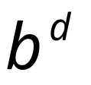
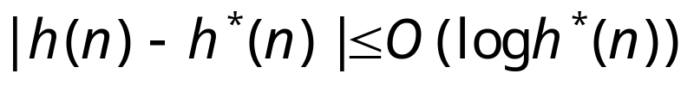
Properties of A*
Complete? Yes (unless there are infinitely many nodes with f ≤ f(G) , i.e. path-cost > ε)
Time/Space? Exponential
except if:
Optimal? Yes
Optimally Efficient: Yes (no algorithm with the
same heuristic is guaranteed to expand fewer nodes)

Slide 24
Memory Bounded Heuristic Search: Recursive BFS
How can we solve the memory problem for A* search?
Idea: Try something like depth first search, but let’s not forget everything about the branches we have partially explored.
We remember the best f-value we have found so far in the branch we are deleting.

Slide 25
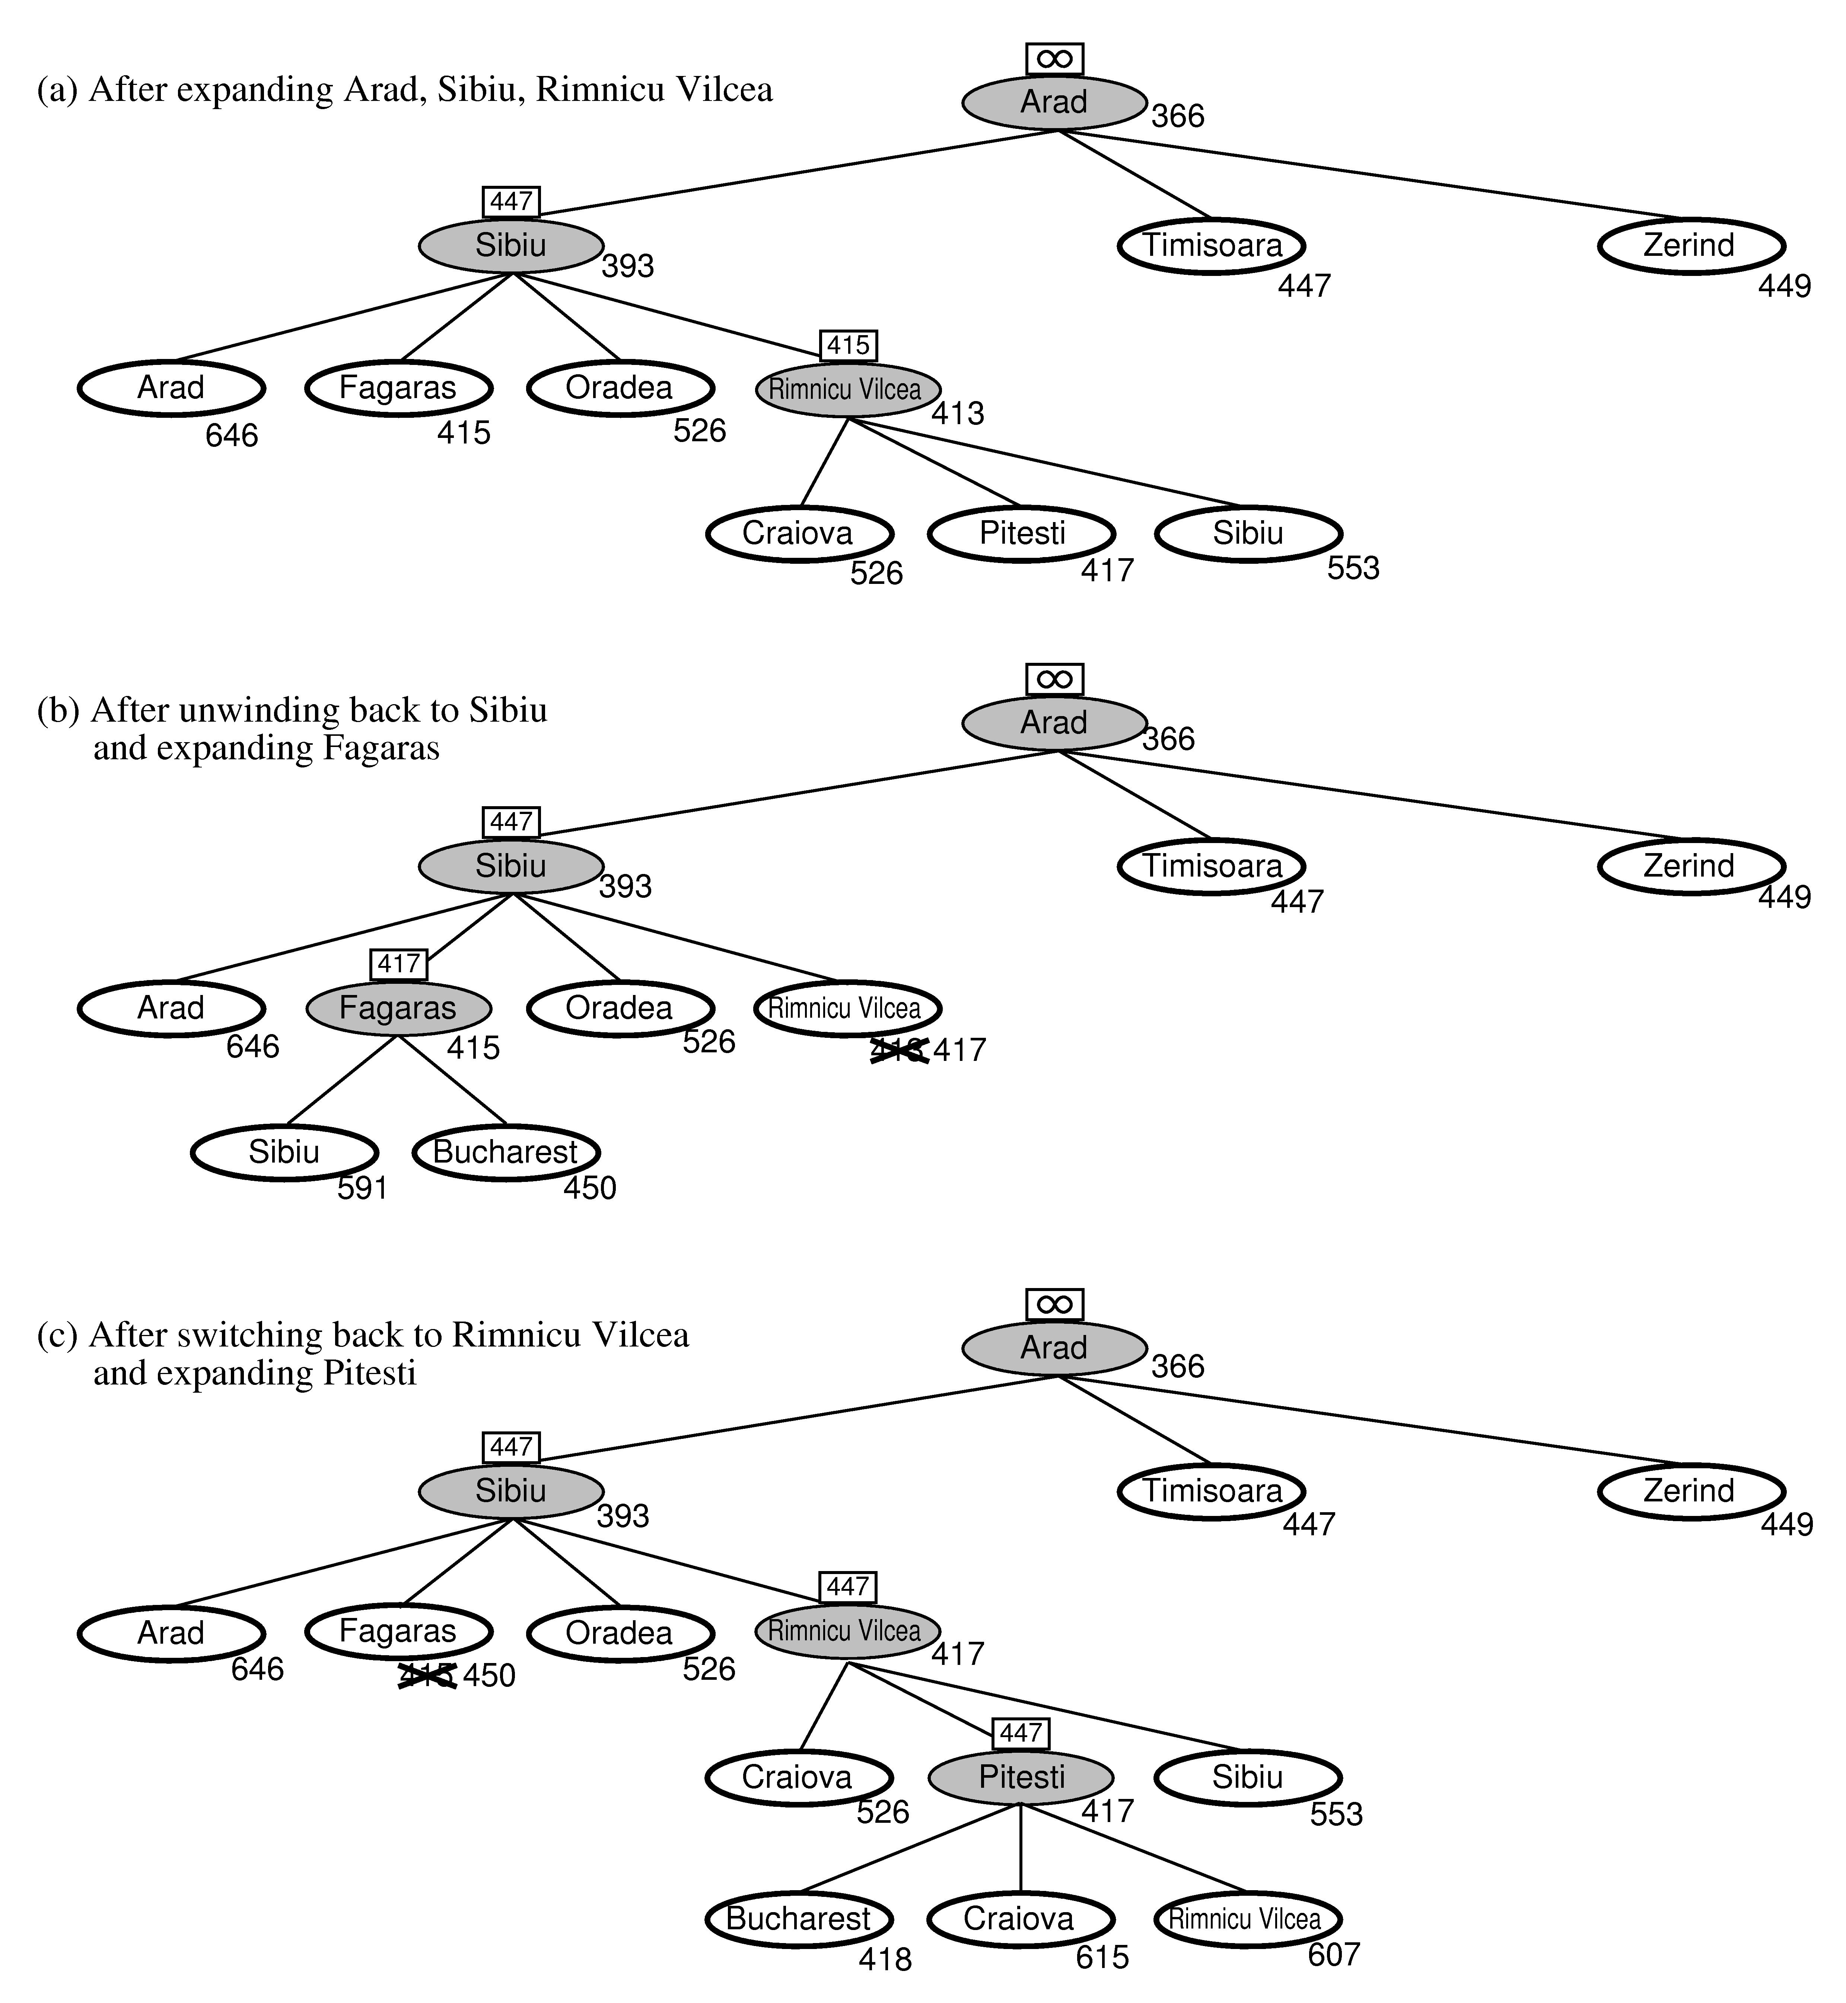
RBFS:
best alternative
over fringe nodes,
which are not children:
do I want to back up?
RBFS changes its mind
very often in practice.
This is because the
f=g+h become more
accurate (less optimistic)
as we approach the goal.
Hence, higher level nodes
have smaller f-values and
will be explored first.
Problem: We should keep
in memory whatever we can.

Slide 26
Simple Memory Bounded A*
This is like A*, but when memory is full we delete the worst node (largest f-value).
Like RBFS, we remember the best descendent in the branch we delete.
If there is a tie (equal f-values) we first delete the oldest nodes first.
simple-MBA* finds the optimal reachable solution given the memory constraint.
Time can still be exponential.

Slide 27

Admissible heuristics
E.g., for the 8-puzzle:
h₁(n) = number of misplaced tiles
h₂(n) = total Manhattan distance
(i.e., no. of squares from desired location of each tile)
h₁(S) = ?
h₂(S) = ?

Slide 28
Admissible heuristics
E.g., for the 8-puzzle:
h₁(n) = number of misplaced tiles
h₂(n) = total Manhattan distance
(i.e., no. of squares from desired location of each tile)
h₁(S) = ? 8
h₂(S) = ? 3+1+2+2+2+3+3+2 = 18

Slide 29
Dominance
If h₂(n) ≥ h₁(n) for all n (both admissible)
then h₂ dominates h₁
h₂ is better for search: it is guaranteed to expand
less nodes.
Typical search costs (average number of nodes expanded):
d=12 IDS = 3,644,035 nodes
A*(h₁) = 227 nodes
A*(h₂) = 73 nodes
d=24 IDS = too many nodes
A*(h₁) = 39,135 nodes
A*(h₂) = 1,641 nodes

Slide 30
Relaxed problems
A problem with fewer restrictions on the actions is called a relaxed problem
The cost of an optimal solution to a relaxed problem is an admissible heuristic for the original problem
If the rules of the 8-puzzle are relaxed so that a tile can move anywhere, then h₁(n) gives the shortest solution
If the rules are relaxed so that a tile can move to any adjacent square, then h₂(n) gives the shortest solution

Slide 31
Local search algorithms
In many optimization problems, the path to the goal is irrelevant; the goal state itself is the solution
State space = set of "complete" configurations
Find configuration satisfying constraints, e.g., n-queens
In such cases, we can use local search algorithms
keep a single "current" state, try to improve it.
Very memory efficient (only remember current state)

Slide 32

Example: n-queens
Put n queens on an n × n board with no two queens on the same row, column, or diagonal
Note that a state cannot be an incomplete configuration with m<n queens

Slide 33

Hill-climbing search
Problem: depending on initial state, can get stuck in local maxima

Slide 34

Hill-climbing search: 8-queens problem
Each number indicates h if we move
a queen in its corresponding column
h = number of pairs of queens that are attacking each other, either directly or indirectly (h = 17 for the above state)

Slide 35

Hill-climbing search: 8-queens problem
A local minimum with h = 1

Slide 36
Simulated annealing search
Idea: escape local maxima by allowing some "bad" moves but gradually decrease their frequency.
This is like smoothing the cost landscape.

Slide 37
Properties of simulated annealing search
One can prove: If T decreases slowly enough, then simulated annealing search will find a global optimum with probability approaching 1 (however, this may take VERY long)
Widely used in VLSI layout, airline scheduling, etc.

Slide 38
Local beam search
Keep track of k states rather than just one.
Start with k randomly generated states.
At each iteration, all the successors of all k states are generated.
If any one is a goal state, stop; else select the k best successors from the complete list and repeat.

Slide 39
Genetic algorithms
A successor state is generated by combining two parent states
Start with k randomly generated states (population)
A state is represented as a string over a finite alphabet (often a string of 0s and 1s)
Evaluation function (fitness function). Higher values for better states.
Produce the next generation of states by selection, crossover, and mutation

Slide 40


Fitness function: number of non-attacking pairs of queens (min = 0, max = 8 × 7/2 = 28)
24/(24+23+20+11) = 31%
23/(24+23+20+11) = 29% etc
fitness:
#non-attacking queens
probability of being
regenerated
in next generation

Slide 41
Appendix
Some details of the MBA* next.

Slide 42
SMA* pseudocode (not in 2nd edition 2 of book)
function SMA*(problem) returns a solution sequence
inputs: problem, a problem
static: Queue, a queue of nodes ordered by f-cost
Queue ← MAKE-QUEUE({MAKE-NODE(INITIAL-STATE[problem])})
loop do
if Queue is empty then return failure
n ← deepest least-f-cost node in Queue
if GOAL-TEST(n) then return success
s ← NEXT-SUCCESSOR(n)
if s is not a goal and is at maximum depth then
f(s) ← ∞
else
f(s) ← MAX(f(n),g(s)+h(s))
if all of n’s successors have been generated then
update n’s f-cost and those of its ancestors if necessary
if SUCCESSORS(n) all in memory then remove n from Queue
if memory is full then
delete shallowest, highest-f-cost node in Queue
remove it from its parent’s successor list
insert its parent on Queue if necessary
insert s in Queue
end

Slide 43
Simple Memory-bounded A* (SMA*)
(Example with 3-node memory)
Search space
Progress of SMA*. Each node is labeled with its current f-cost. Values in parentheses show the value of the best forgotten descendant.
f = g+h
= goal
A
13[15]
12
A
A
A
A
12
13
G
0+12=12
13
10
8
10+5=15
B
8+5=13
G
15
B
B
G
15
13
18
H
∞
10
10
8
16
C
D
H
I
A
A
A
20+5=25
16+2=18
15[15]
15[24]
20[24]
20+0=20
24+0=24
A
8
10
10
8
8
15
E
F
J
K
G
15
B
B
20[∞]
24[∞]
30+5=35
30+0=30
24+0=24
24+5=29
B
G
I
15
24
C
25
D
24
∞
20
Algorithm can tell you when best solution found within memory constraint is optimal or not.

